Slide 1
Burning Mouth Syndrome
- a frequently unrecognised condition
Dr Tim Poate
Consultant in Oral Medicine
King’s College Hospital
The Lister Hospital, Chelsea

Slide 2
Causes of a sore mouth
Anaemia
Mucosal diseases (Lichen planus)
Trauma
Ulcers
Geographic tongue
Burning Mouth Syndrome
Infections (thrush)
Drugs
Xerostomia
Cancer

Slide 3
BMS symptoms
Burning
Saliva feels
different
Abnormal taste

Slide 4
BMS symptoms 2
Raw
Teeth are coated
Scalded
Peeling
Bad breath
Mouth feels dirty
Feeling of cracks / ulcers
Feeling of sandpaper
Lumpy

Slide 5
Different names for BMS
‘Burning Mouth Syndrome’
‘Oral dysaesthesia’
‘Burning tongue’
‘Glossodynia’
‘Stomatodynia’

Slide 6
Sites affected

Slide 7
BMS – classical features
Usually women
Usually menopausal / post-menopausal
Have often had the symptoms for months / years
Have often seen many doctors / dentists / specialists
Often have been repeatedly told that nothing is wrong
May have been given repeated courses of antibiotic or antifungal therapy without benefit

Slide 8
BMS – classical features
Often left thinking that everyone thinks that you are making it up or it is ‘all in the head’
Often think that there is a serious cause that has not yet been found
Often worried that it is due to cancer
Often has become a considerable cause of frustration, concern, anger, depression with a considerable impact on mood, social life, relationships and enjoyment of life.

Slide 9
BMS - timing
Type 1 Pain-free on awakening
Burning commences in late morning Increase in severity throughout day
Reaches a peak in the evening.
Type 2 Continuous symptoms throughout the day
Type 3 Intermittent symptoms

Slide 10
BMS – common associations
Stress
Depression
Other chronic pains
Anxiety
Irritable bowel Syndrome
Chronic fatigue

Slide 11
BMS causes
Neuropathic
Hormonal
Psychogenic

Slide 12
How common is BMS?
1427 subjects
758 Women
669 Men
Age range 20-69
PDH service registers
Sweden
Examined & interviewed
Diagnosed with BMS
Bergdahl, Bergdahl Joral Pathol Med 1999; 28:350-4.

Slide 13
What investigations are typically performed?
Saliva test / swab Assess saliva flow rate
Exclude raised candida count
Blood test Exclude anaemia or haematinic deficiency
Others - as indicated to exclude other causes

Slide 14
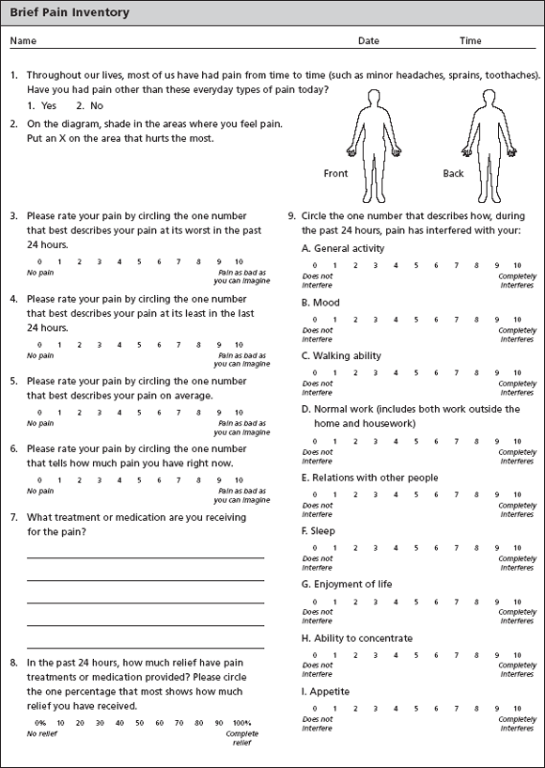

Slide 15
Treatment
Discussion & reassurance
Symptomatic
Drugs
Psychological

Slide 16
BMS - Treatment
Discussion & reassurance
Correct diagnosis
Reassurance
Explanation
Correct any abnormal findings (eg candida, iron)
Stress reduction
Relaxation

Slide 17
BMS treatment
Discussion & reassurance
Symptomatic
Drugs
Psychological

Slide 18
Antidepressant treatment for BMS
Low dose
Minimal side effects
Essential information for BMS patients -
Needs to be taken daily for many months
May take 2-3 months for effect to begin
Not addictive
When result achieved, and after maintaining results for several months, may be stopped / reduced / continued

Slide 19
Spontaneous remission
Burning Mouth Syndrome: a retrospective study investigating spontaneous remission and response to treatments. Sardella al.
Oral Diseases (2006)12,152-5.

Slide 20
BMS data for patients with over 3 months follow up at KCH

Slide 21
BMS data for patients with over 3 months follow up at KCH

Slide 22
What achieves good results ?
Discussion & reassurance
Symptomatic treatment
Drugs - explanation
Psychological therapy - availability

Slide 23
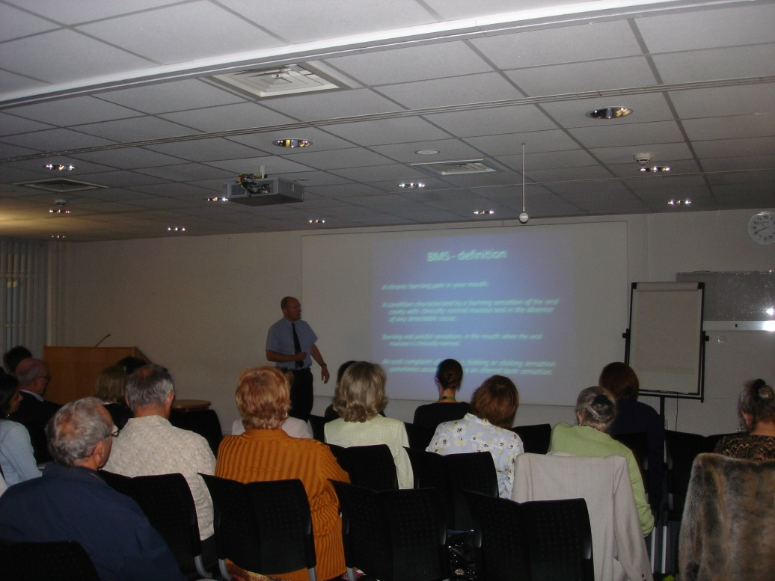
Annual BMS Patient Education Day
King’s College Hospital, London

Slide 24
Burning Mouth Syndrome
Very distressing condition despite normal appearance of mouth
Condition with considerable impact on sufferer and family
Sufferers have often gone years undiagnosed despite seeing many healthcare professionals
Correct diagnosis and reassurance (especially that cancer has been excluded) is vital
Steps to reduce stress and increase relaxation may help
Treatment is available
Results may take months or even years to achieve
Pain often not completely resolved
Halving the severity of pain is a good result

Slide 25
Summary
Increased awareness about Burning Mouth Syndrome in Jersey
Consider BMS in patients with symptoms in absence of clinical findings
Exclude other causes of a sore mouth - candidosis, anaemia, mucosal disease
Reassurance
Provide symptomatic treatment
Consider associated factors – stress, anxiety, depression
Consider drug therapy, psychological therapy
Consider referral

Slide 26
Burning Mouth Syndrome
Dr Tim Poate
King’s College Hospital, London
The Lister Hospital, Chelsea
t.poate@nhs.net
www.oralmedicinelondon.co.uk

